Slide 1
Restful API Post Article
Lutfi Dendiansyah

Slide 2
Prerequisites
Java 17 or newer
Apache Maven 3.8 or newer
NodeJS v18.12.1 or newer

Slide 3
Running Application
Backend
git clone git@github.com:ltfide/mini-project-training.git
cd mini-project
mvn clean package
mvn spring-boot:run
FrontEnd
cd mini-project-ui
npm install
Npm run dev

Slide 4
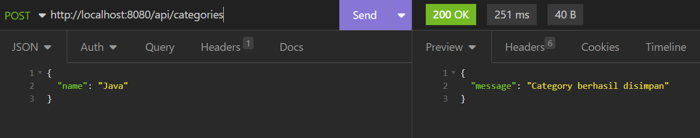
Create Category

Slide 5
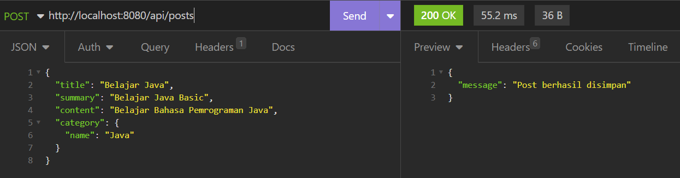
Save Post

Slide 6
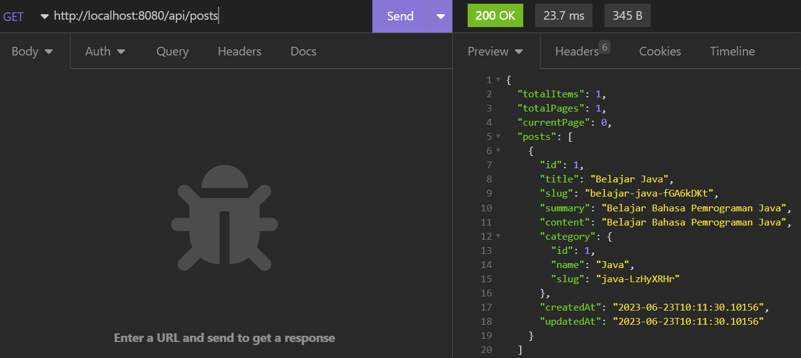
GET All Data Posts

Slide 7
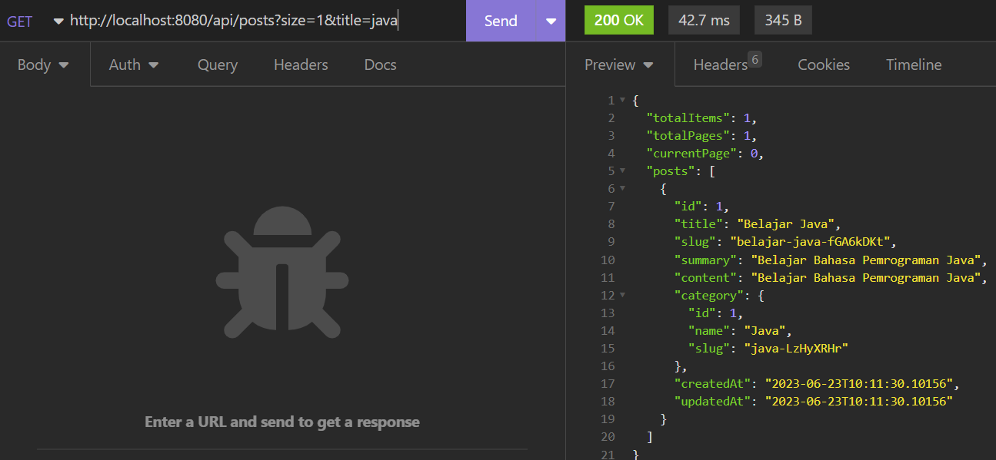
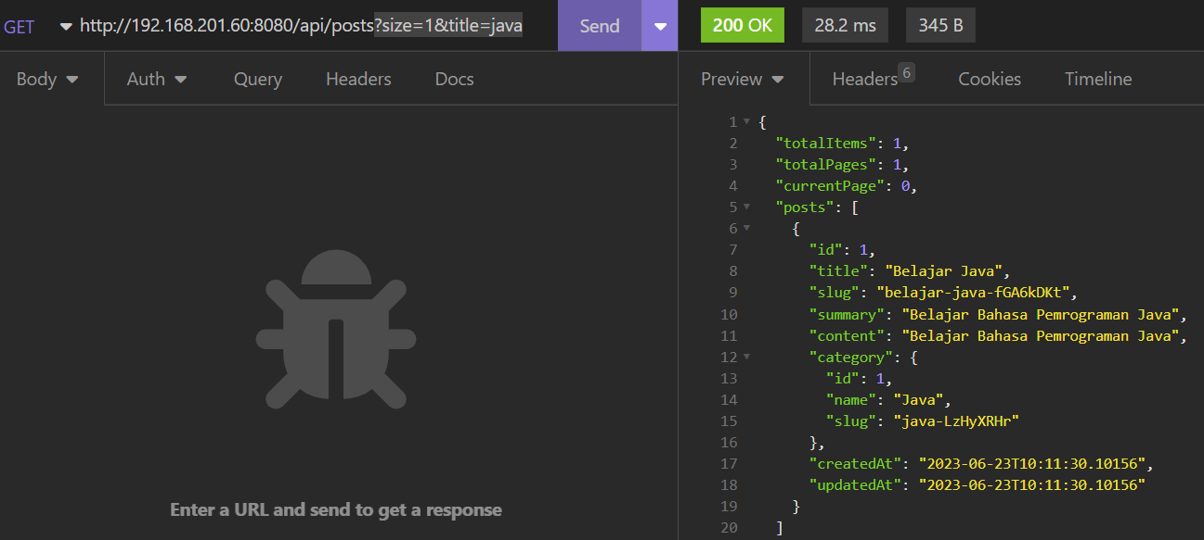
With Pagination & Filter

Slide 8
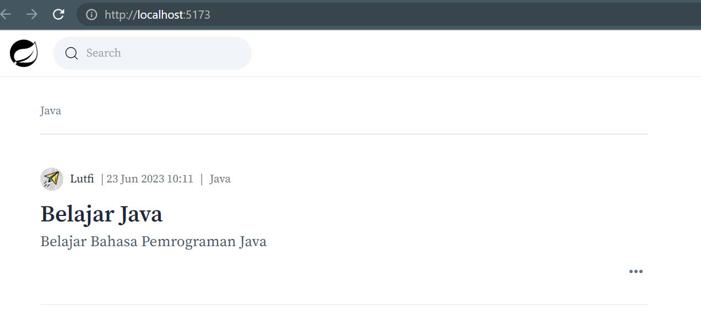
Test on FrontEnd

Slide 9
TERIMA KASIH

